Slide 1
Introduction to Generative AI
Hari Khanal, Phd
AL/ML Scientist, Lockheed Martin

Slide 2
How Machine Learning Works
Algorithm
$$(X,y)$$
$$f(X;w)=y_{pred}$$
$$J(w)=min(y_{pred}-y)^{2}$$

Slide 3
Neural Networks

Slide 4
What ML does
Prediction (forecast)
Detection
Classification
Synthesis or generation

Slide 5
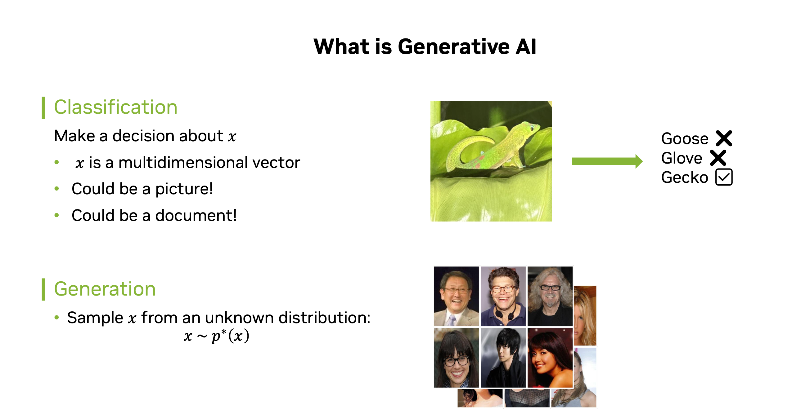

Slide 6
GANs
Prominent framework for generative AI
Invented by Ian Goodfellow in Jun , 2014
People who never exist

Slide 7
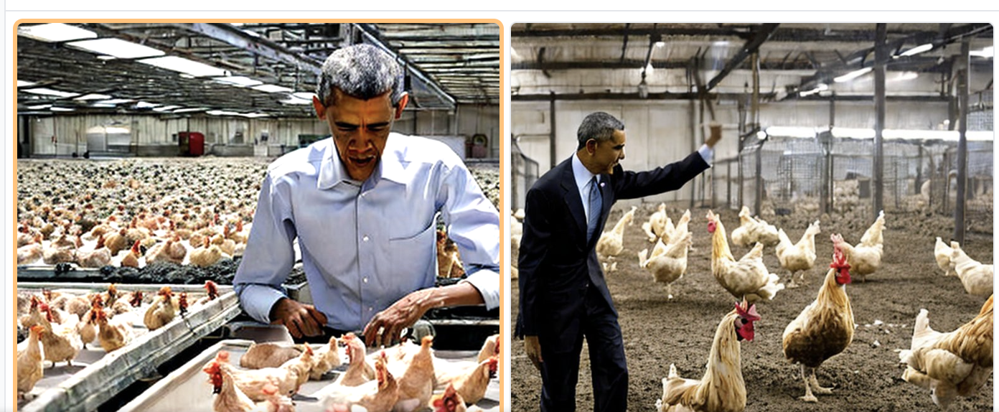
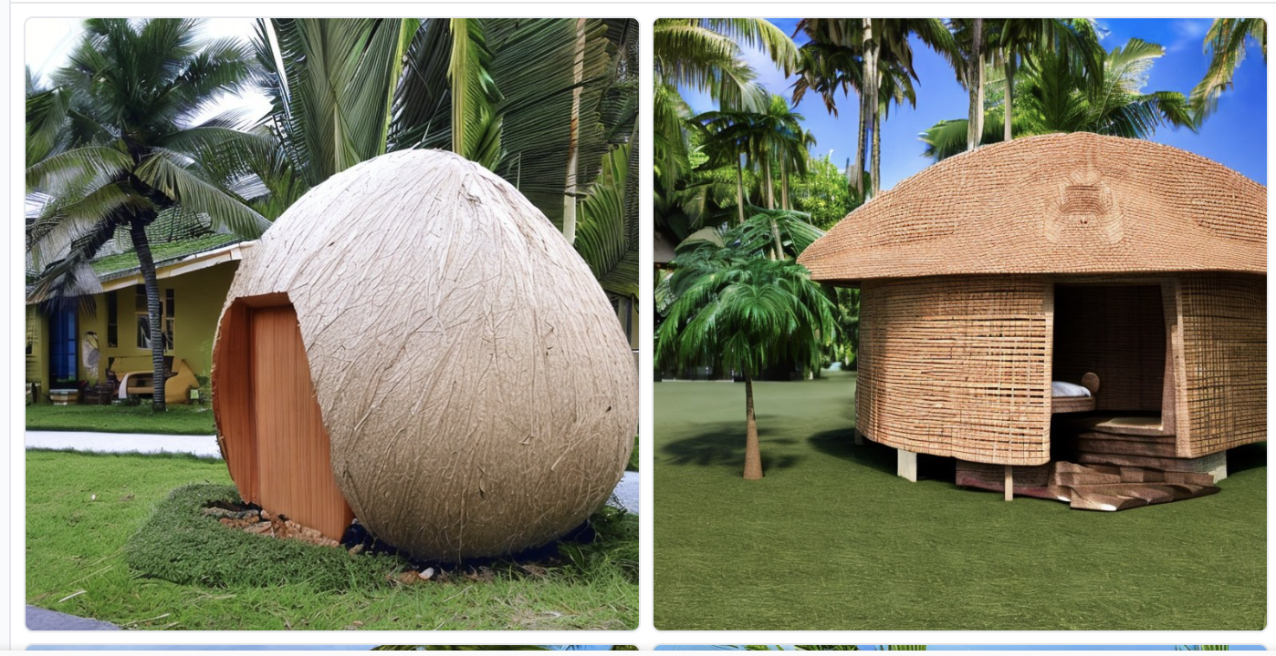
Text to Image Generator
DALL-E , version of GPT3 to generate the image from Text
12 Billion Parameters, trained with image-text pairs
Obama working in Chicken Farm
House with Coconut shape

Slide 8
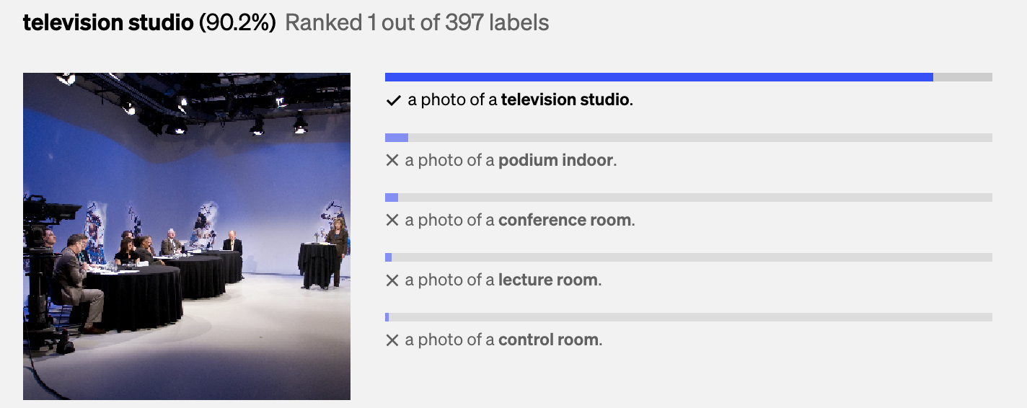
Image to text (caption)
OpenAI CLIP (Contrastive Language-Image Pre-Training) predicts the most relevant text snippet, given an image
Trained with 400 million image-pairs
https://github.com/openai/CLIP

Slide 9
NVIDA eDiff-l (image fusion)
https://research.nvidia.com/labs/dir/eDiff-I/

Slide 10
What is GPT-3 ?
Predicting the next token from a given sentence
There are 2048 tokens
300 billion Tokens
Released in 2020

Slide 11
How GPT-3 works
Pre-training
Transformer-techniques
Fine-tuning
Prompt-based generation
Calculating the probability of the next
word appearing,
surrounded by the other ones
We are opening a shop in Damak, and focusing on the customer satisfaction
Elephant, Jacket

Slide 12
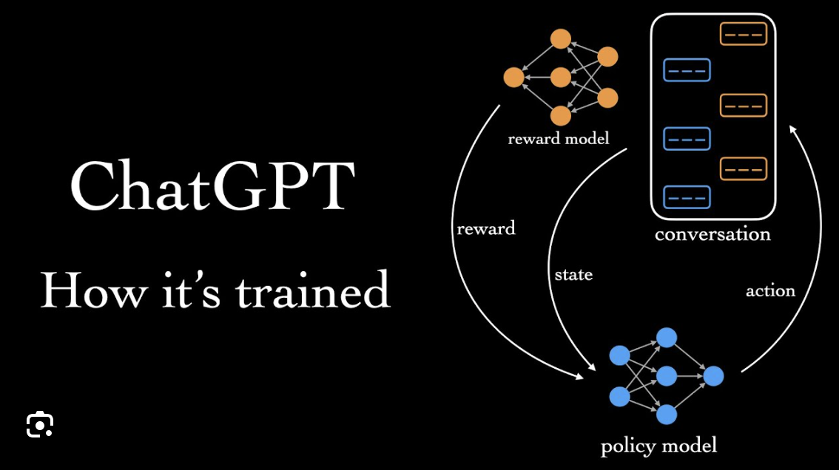
ChatGTP
ChatGPT is built upon GPT-3.5 and GPT-4

Slide 13
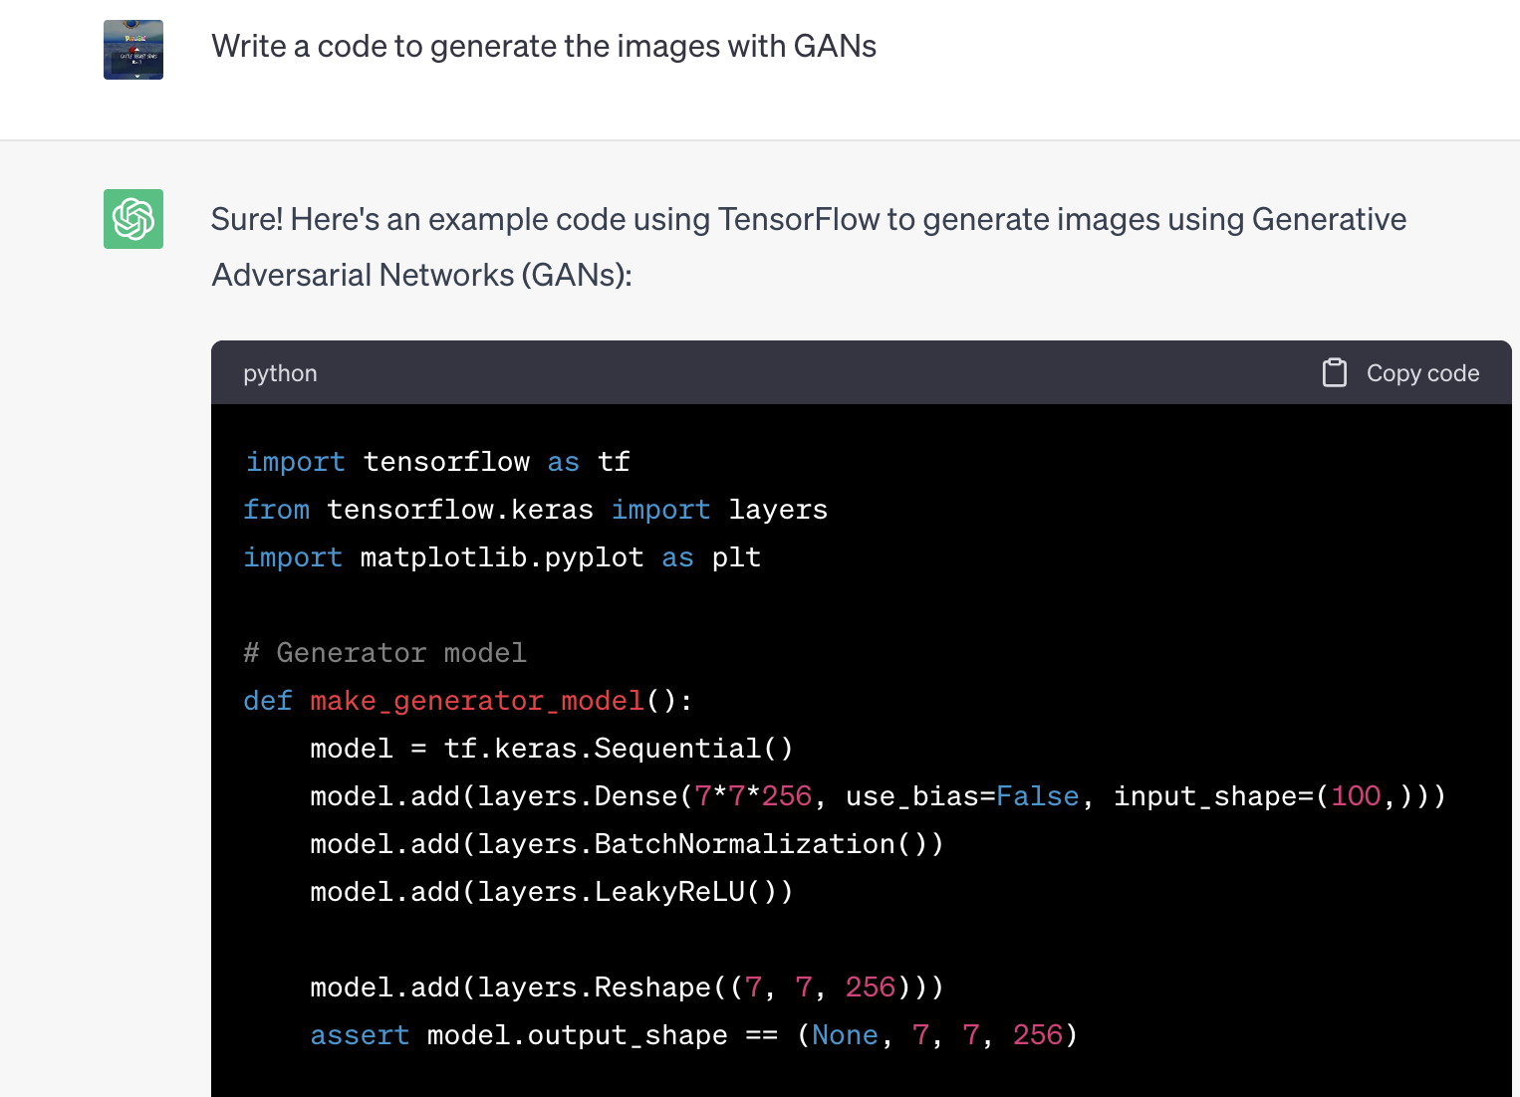
ChatGTP

Slide 14
Use cases of GAI
Image Generation
Text Generation
Video Creation
Data Augmentation
Engineering Design

Slide 15
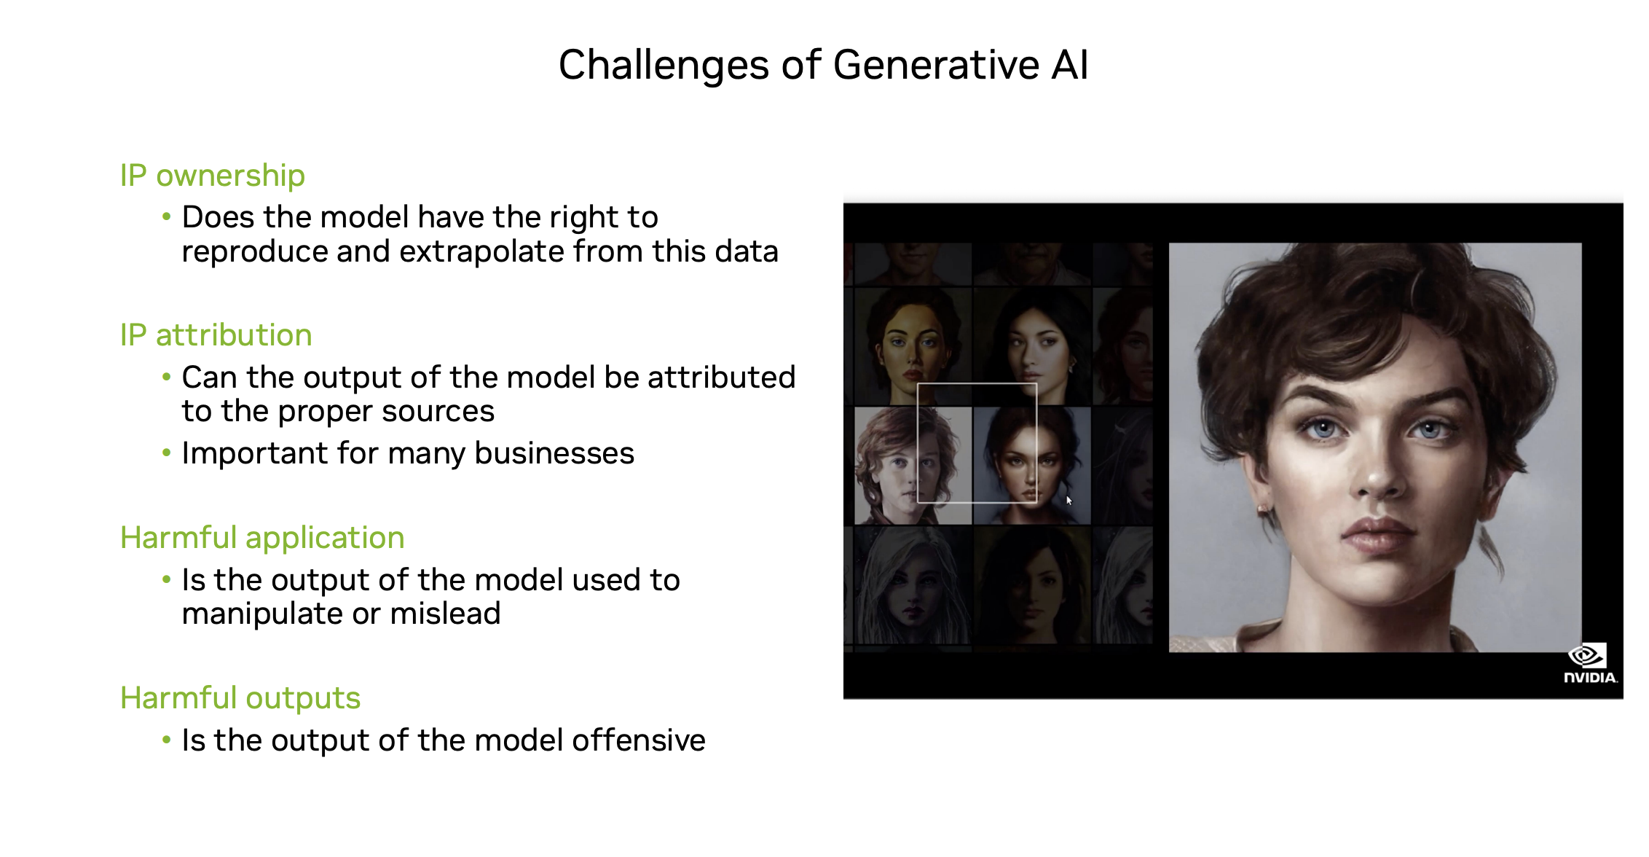

Slide 16
Conclusion
AIG is the powerful tool to solve many problems
We could generate, text, images, music and discover drugs
Distribution of harmful content, Copyright and legal exposure,
Data privacy violations, Sensitive information disclosure

Slide 17
Q&A

Slide 18
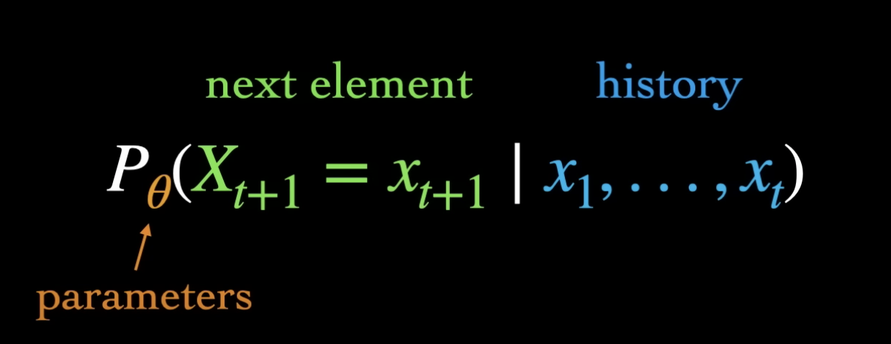
What is language Model

Slide 19
Creating the Training Data
Addressing these problems requires ongoing research and advancements in generative AI techniques, model architectures, training algorithms, evaluation metrics, and ethical guidelines to ensure responsible and reliable use of generative AI technologies.
Addressing these problems requires ongoing research and advancements
these problems requires ongoing research and advancements in

Slide 20
Workflow in Language
Input text
Text Embedding
Preprocessing
Predict
Save Model
Training

